Slide 1


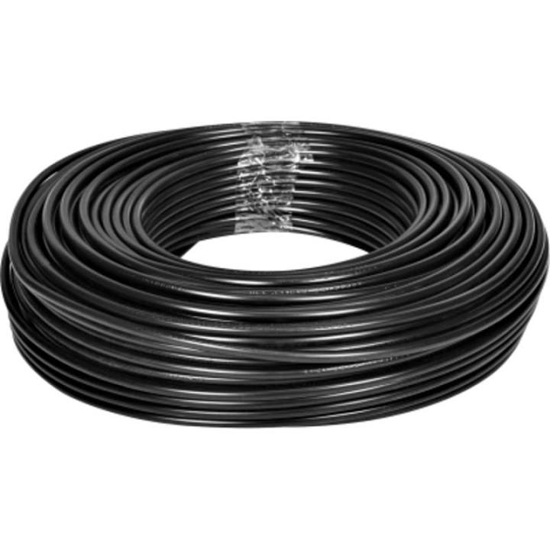
Slindimpilo Development (PTY) LTD

Slide 2

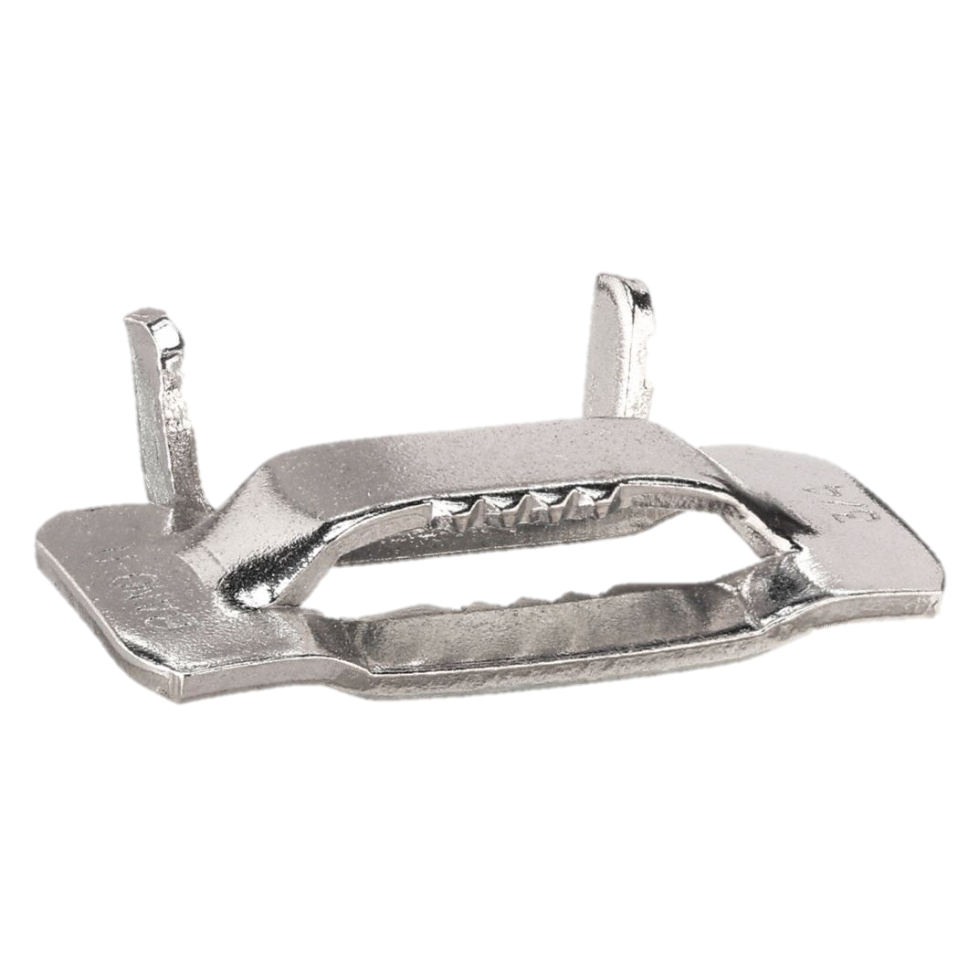
Slindimpilo Development (PTY) LTD

Slide 3



Slide 4


Slindimpilo Development (PTY) LTD

Slide 5

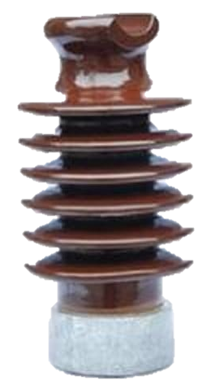
Slindimpilo Development (PTY) LTD

Slide 6

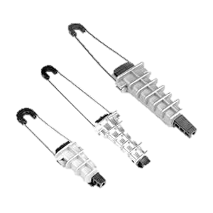
Slindimpilo Development (PTY) LTD

Slide 7

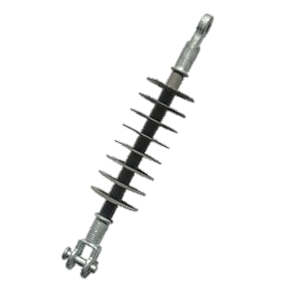
Slindimpilo Development (PTY) LTD

Slide 9
Slindimpilo Development (PTY) LTD

Slide 10


